Slide 1

Professionalism in Officiating
Key concepts for Maintaining Integrity and Respect

Slide 2
TBOA uphold high expectations
Definition:
Professionalism in officiating means
upholding high standards of:
    integrity, impartiality
    respect, knowledge
Importance:
Officials shape the game's fairness
and influence the experience of players,
coaches, and fans.

Slide 3

Consistency and fairness
•Ensuring uniform application of the rules throughout the game.
Treating all players, coaches, and teams with impartiality and respect.
Avoiding favoritism or bias, regardless of team reputation or crowd influence.

Slide 4
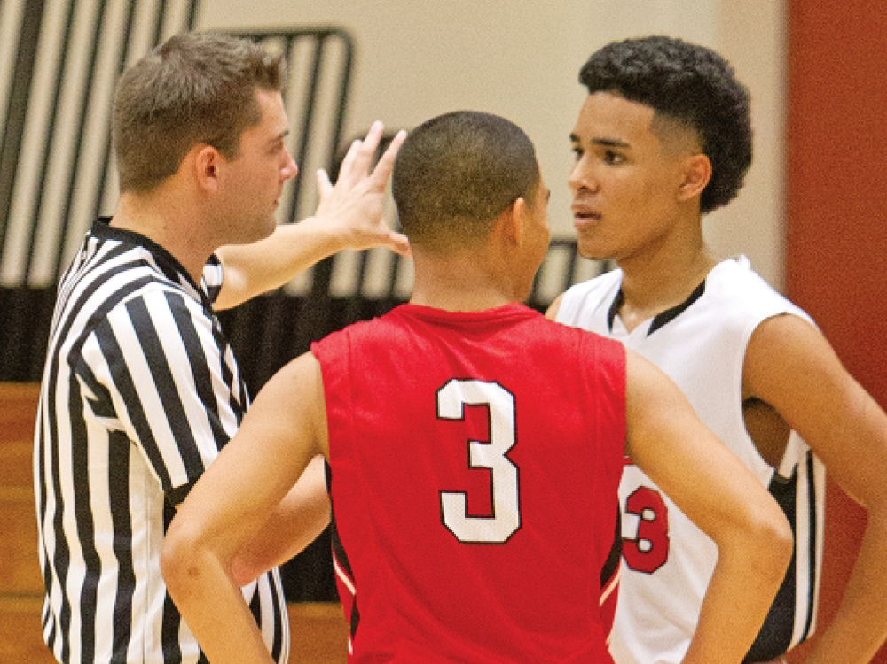
Verbal and non verbal communication
Clear and concise communication with players, coaches, and fellow officials.
Using a calm and assertive tone when making calls or explaining decisions.
Maintaining effective non-verbal communication through signals and body language.
Using reporting area, hustling as if you are a player, and positioning adjusting to get the best angle on the play.

Slide 5

Knowledge of the Rules
Continuous study and understanding of the game’s evolving rules and regulations.
Ability to adapt to different levels of play (e.g., high school, college, recreation and AAU).
Confidence in making decisions based on a thorough understanding of the game.
NFHS, TBOA, point of emphasis and rule changes are mandatory.

Slide 6

Physical and mental preparedness
Maintaining physical fitness to keep up with the pace of the game.
Mental sharpness to make quick, accurate decisions under pressure.
Managing stress and staying composed in challenging situations.

Slide 7
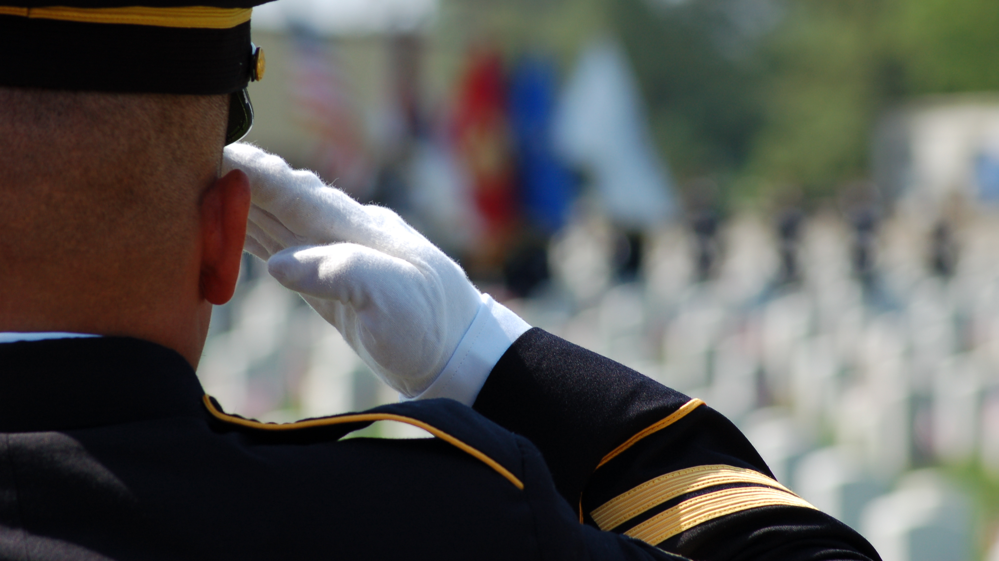
Appearance and behavior
Adhering to a professional dress code and personal grooming standards.
Displaying respectful behavior at all times, both on and off the court.
Modeling sportsmanship, integrity, and discipline for players and coaches.
Body language, facial expressions, confidence, presence

Slide 8
Respect for the Game and Its Participants
Respect the game, respect for the crew, respect for yourself
Showing respect for coaches, players, and fans, regardless of the situation.
Upholding the integrity of the sport by making the right calls even in tough moments.
Understanding the impact of officiating on the overall experience of the game.

Slide 9

Handling conflict and criticism
DO’S
Responding calmly and professionally to heated situations or disagreements.
Accepting constructive criticism and seeking continual improvement.
Managing emotions in the face of hostility or pressure from external sources.
DON’T’S
Lose control of emotions
Engage in arguments or debates
Let external distractions affect you
Take calls personally or seriously
Hold a grudge
Allows coaches or players to influence your calls

Slide 10
Professional Development
Commitment to ongoing education and training through clinics, workshops, and game evaluations.
Being accountable, open to feedback without being offending, and holding others to high standards
Seeking feedback from officials and mentors to improve performance.
Striving for excellence and setting personal standards for growth.

Slide 11

What TBOA officials have reported
Using a cellphone mind game
Belts, sweatpants, and non-WOA shirts
Continuous walking, not rotating, no use of the reporting area
No text or communication before the game
Know the names of your partners (and probably the coaches)
WHAT ELSE?

Slide 12

A challenge to each of you
Work on getting better each game
Ask for feedback once a week
“what is one thing you saw that I could work on?”
Be a better person off the court –
let that influence the rest of your life successfully
Grow and be curious

